Slide 1


<Name of Event Goes Here>
<Event Logo Goes Here>
<Date of Event Goes Here>
Culturally Competent Social Robotics for Africa
<Name of Presenter Goes Here>
Select your logo or logos

Slide 2


www.cssr4africa.org
Project started in July 2023

Slide 3
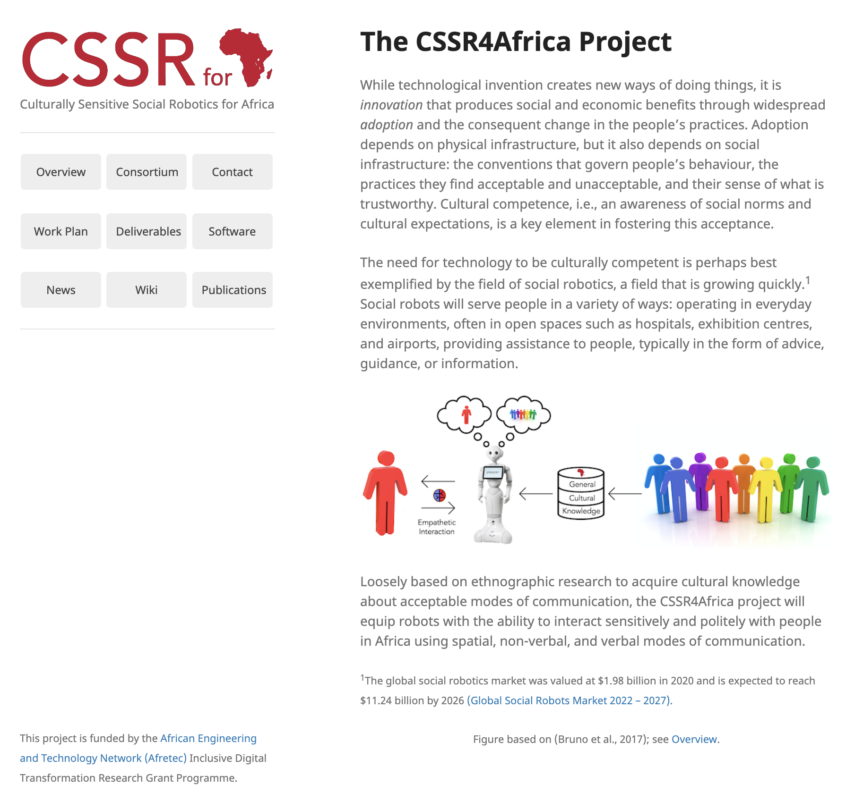
www.cssr4africa.org

Slide 4



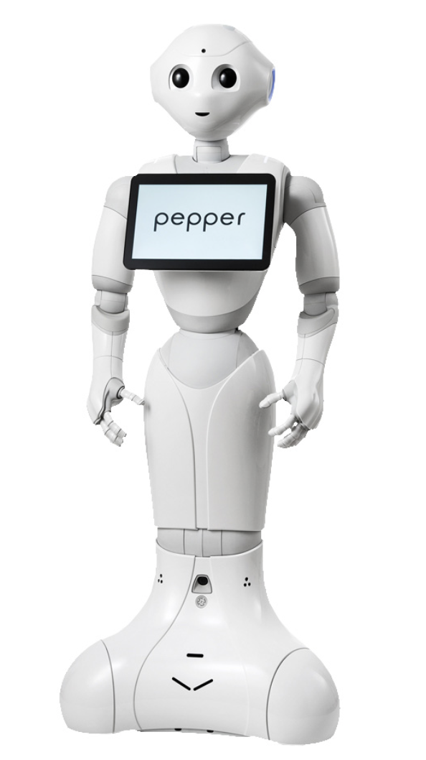



General
Cultural
Knowledge
Empathetic Interaction
Graphic based based on work by Bruno et al. (2017)

Slide 5
Culturally Competent
Social Robot
Cultural knowledge representation
1
{Bruno et al, 2017}

Slide 6
Culturally Competent
Social Robot
Cultural knowledge representation
1
{Bruno et al, 2017}
Culturally sensitive planning and action execution
2

Slide 7
Culturally Competent
Social Robot
Cultural knowledge representation
1
{Bruno et al, 2017}
Culturally sensitive planning and action execution
2
Culturally aware multimodal human-robot interaction
3

Slide 8
Culturally Competent
Social Robot
Cultural knowledge representation
1
{Bruno et al, 2017}
Culturally sensitive planning and action execution
2
Culturally aware multimodal human-robot interaction
3
Culture-aware human emotion recognition
4

Slide 9
Culturally Competent
Social Robot
Cultural knowledge representation
1
{Bruno et al, 2017}
Culturally sensitive planning and action execution
2
Culturally aware multimodal human-robot interaction
3
Culture-aware human emotion recognition
4
Culture identity assessment, habits, and preferences
5

Slide 10

Cultural knowledge representation
1
Culturally Sensitive
Social Robot
Culturally sensitive planning and action execution
2
Culturally aware multimodal human-robot interaction
3
Culture-aware human emotion recognition
4
Culture identity assessment, habits, and preferences
5

Slide 11

General
Cultural
Knowledge
Empathetic Interaction

Slide 12
General
Cultural
Knowledge
Empathetic Interaction

Slide 13
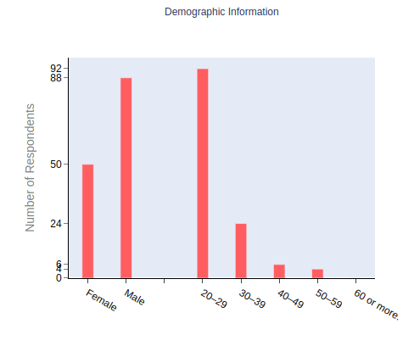
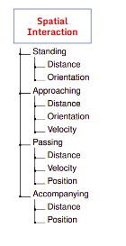
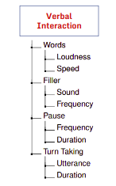
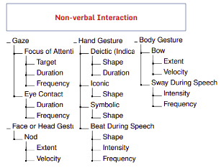
Pilot Survey of Rwandan Cultural Knowledge
Online survey with 59 questions (English and Kinyarwanda)
Conducted at Carnegie Mellon University Africa
143 responses (108 in English, 35 in Kinyarwanda)
Survey in Kinyrwanda: https://docs.google.com/forms/d/e/1FAIpQLScSu95pCT2MsRohukI9ib6GxsuyXuQozeqGQXO9DYcDD5RvlQ/viewform
Survey in English: https://docs.google.com/forms/d/e/1FAIpQLSc-5lz0YfPCtK5BSL6cGkmlJVkE0vwyKXppkhXs4l1rYPwKlA/viewform
Survey Results Rwandan Cultural Knowledge: https://cssr4africa.github.io/deliverables/CSSR4Africa_Deliverable_D1.2.pdf Cultural Knowledge Ontology and Culture Knowledge Base: https://cssr4africa.github.io/deliverables/CSSR4Africa_Deliverable_D5.4.1.pdf

Slide 14
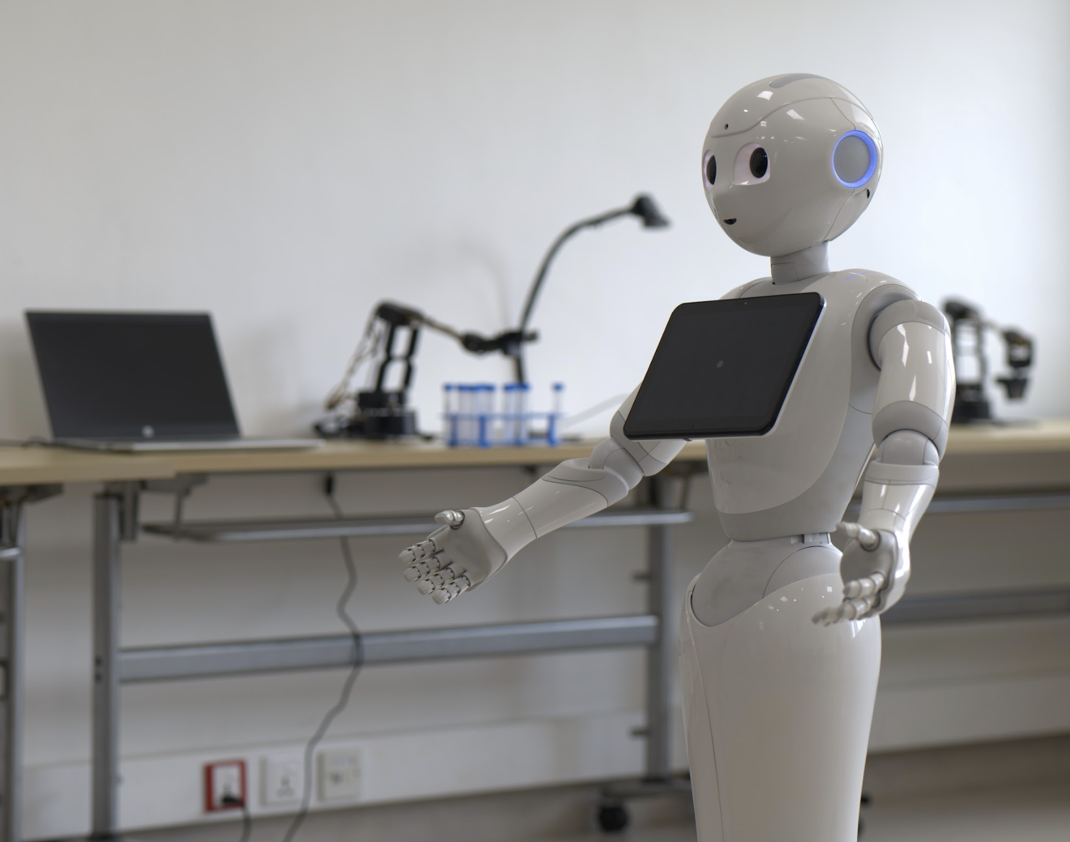
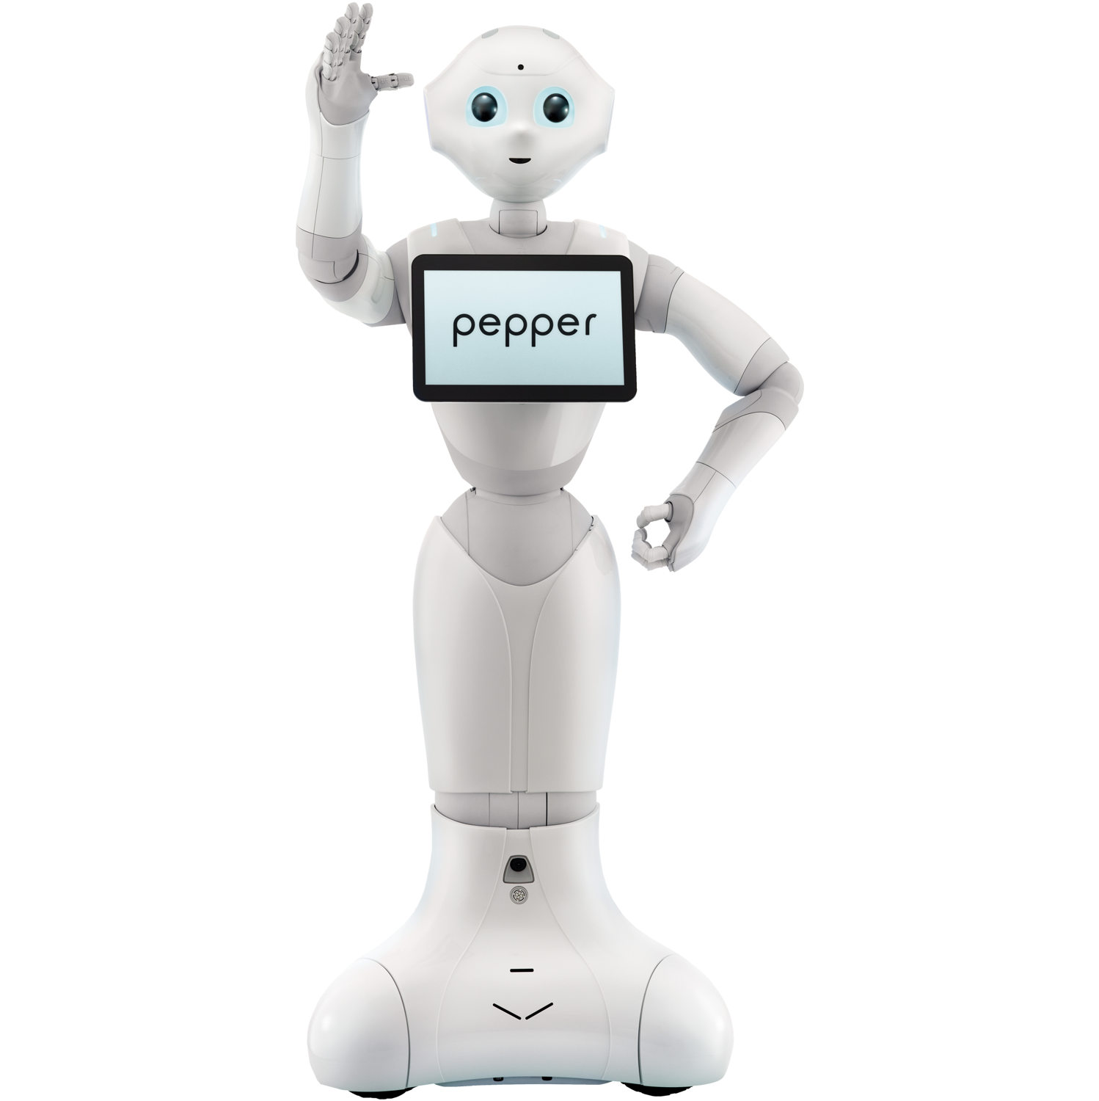

Slide 15
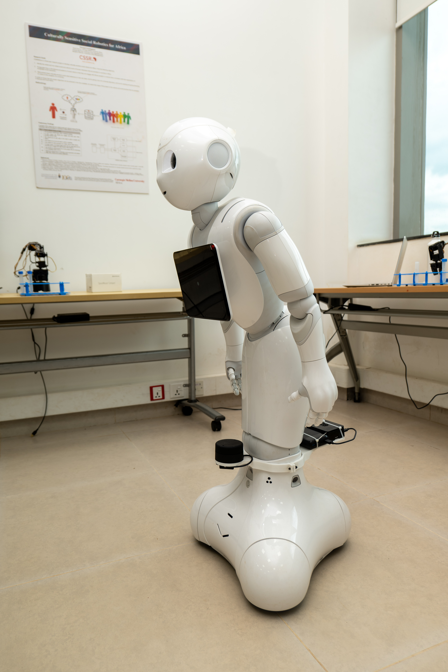
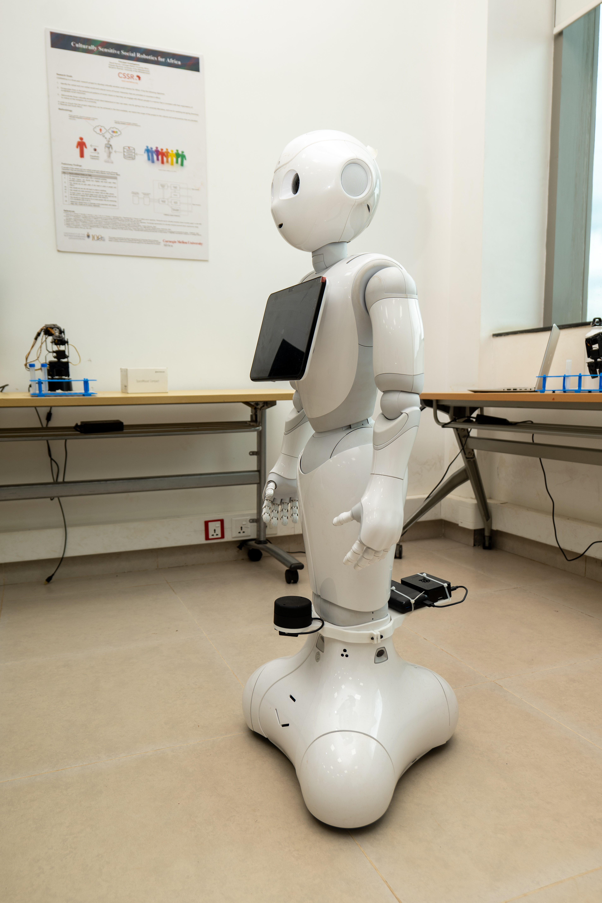
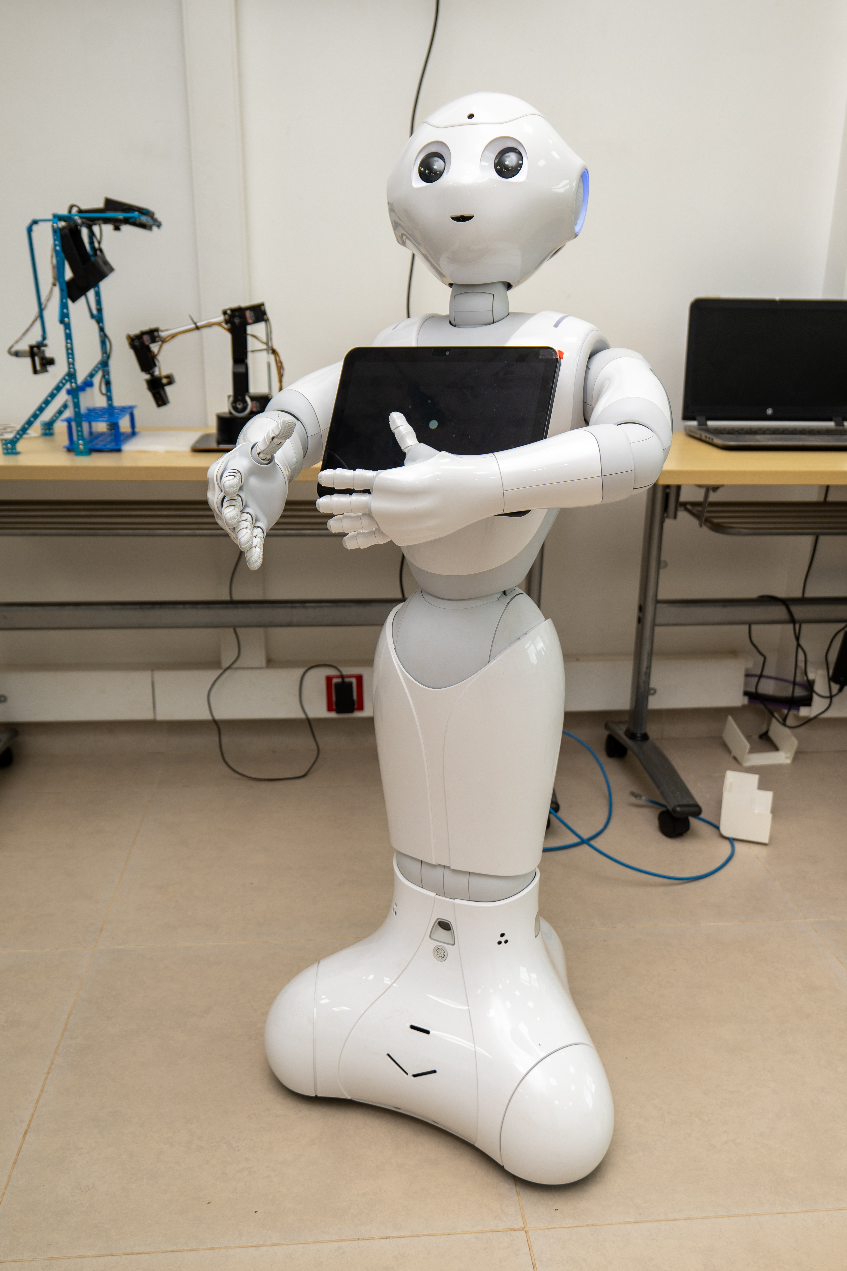
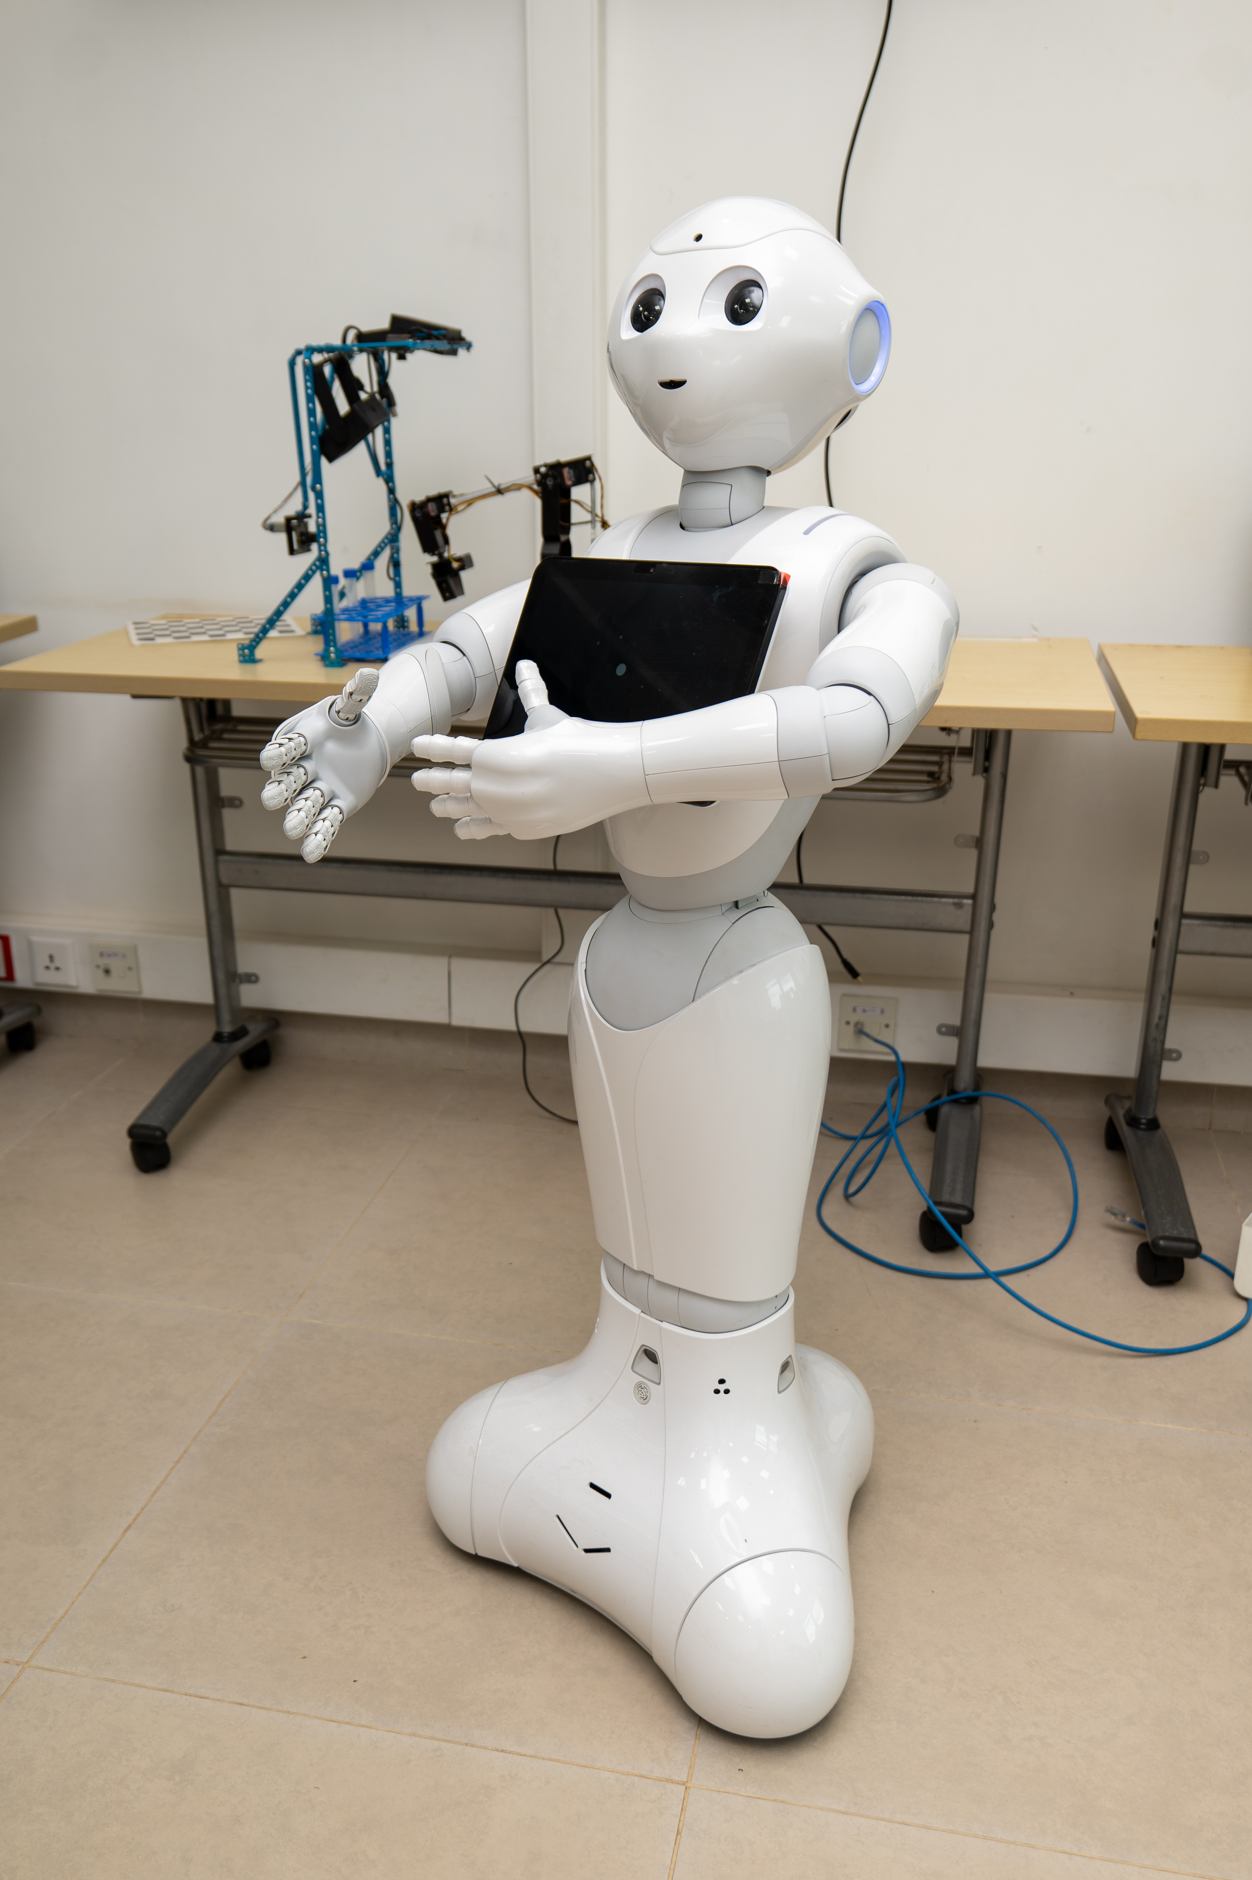

Slide 19
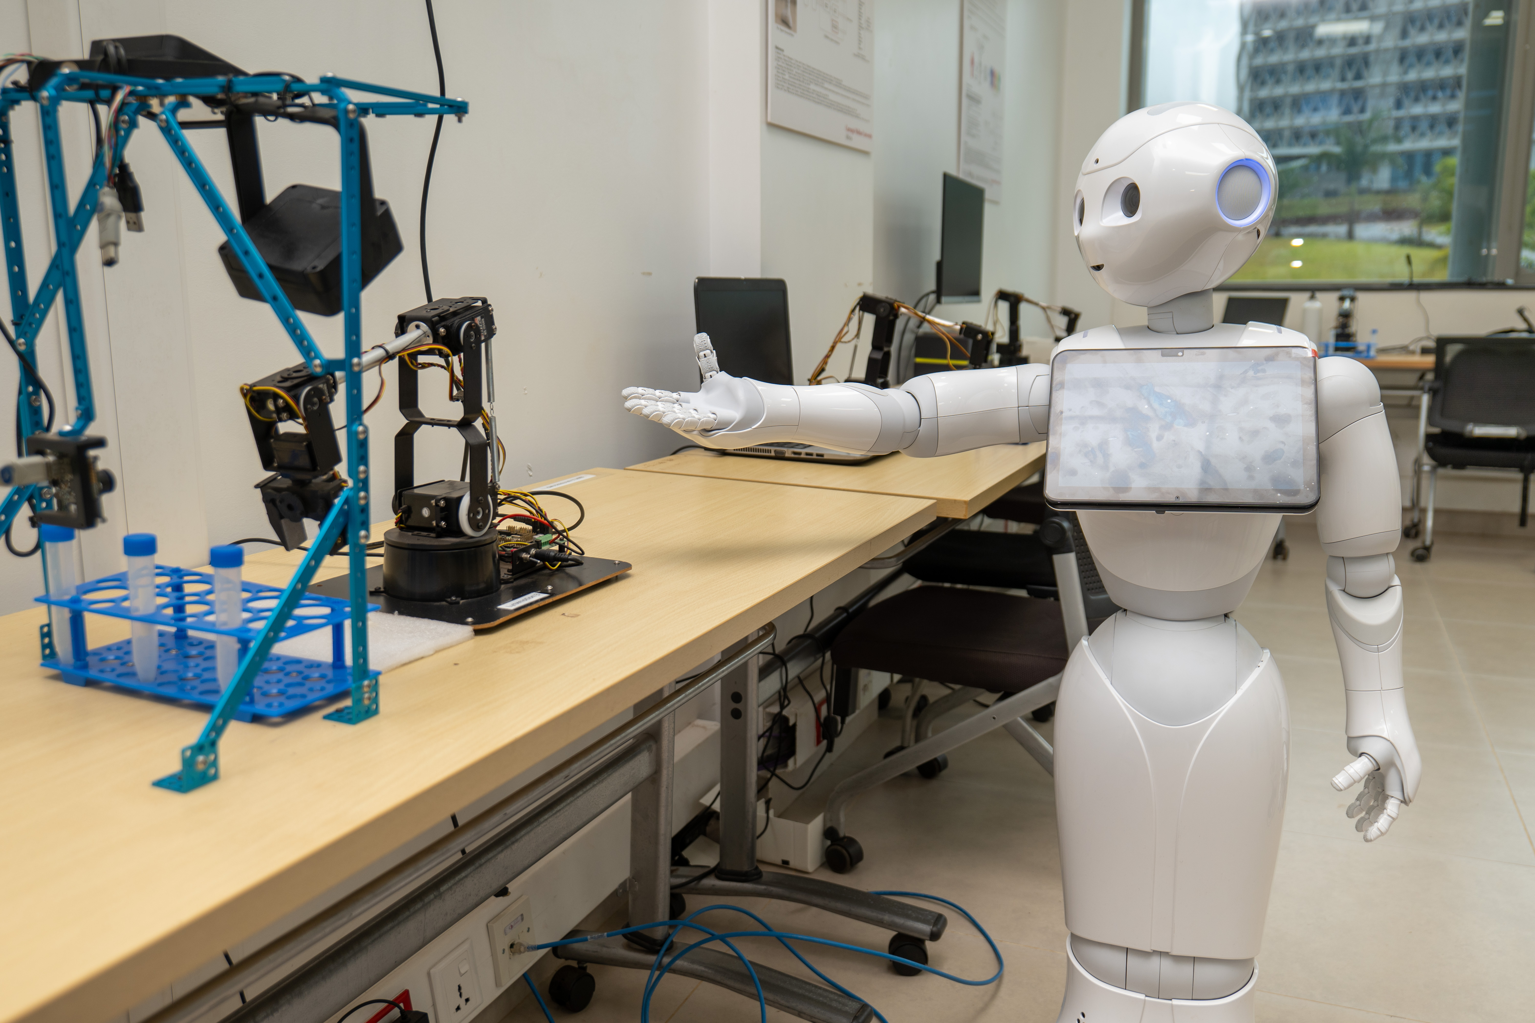

Slide 20
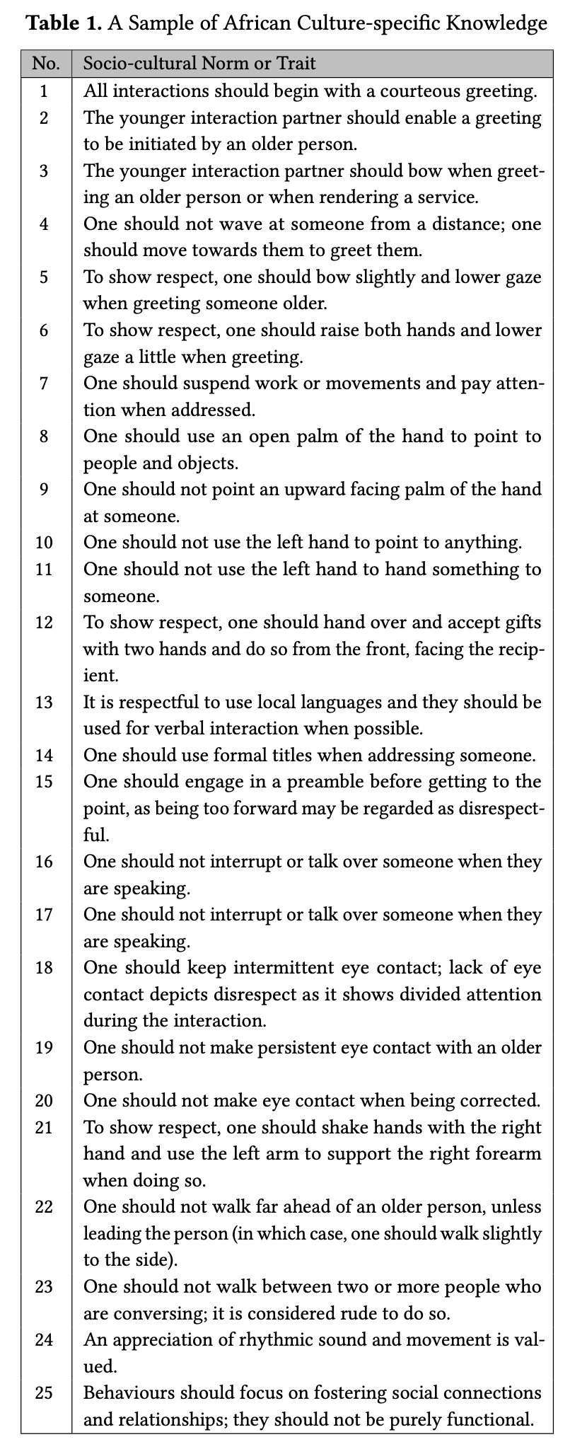
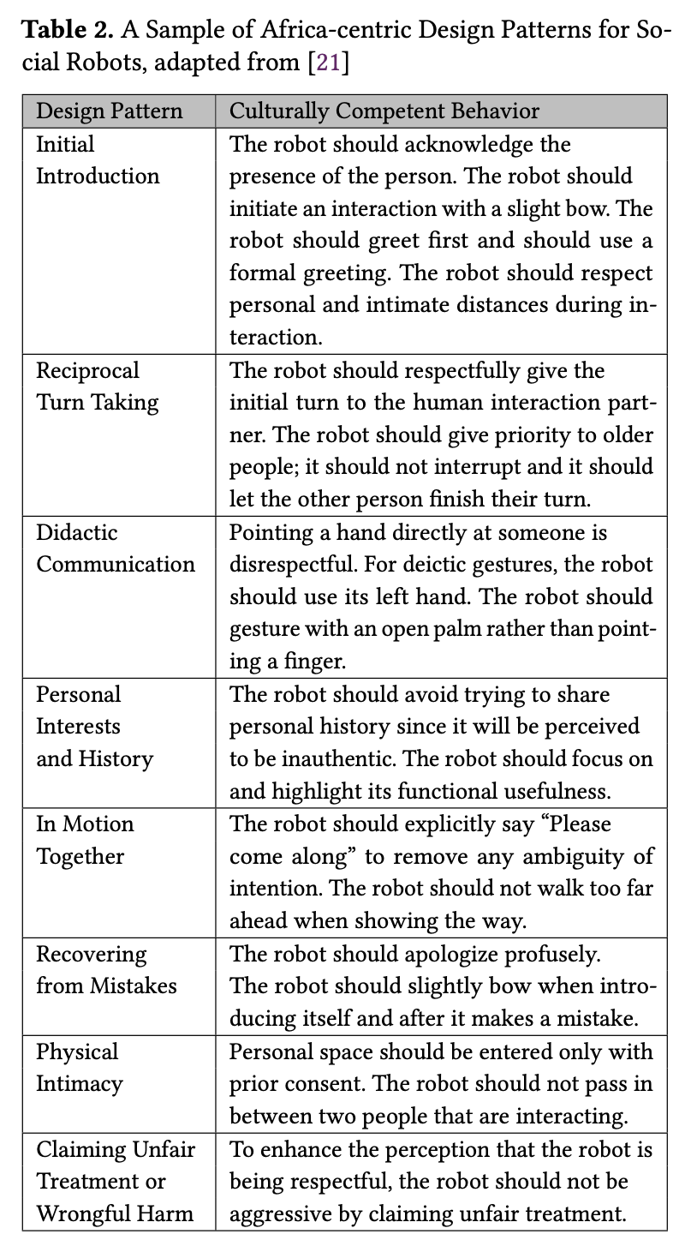
A Sample of African Culture-specific Knowledge
Spatial, Non-verbal,
Verbal Interaction
A Sample of Africa-centric Design Patterns for Social Robots
After (Kahn et al, 2008)
After (Bruno et al, 2019)

Slide 21
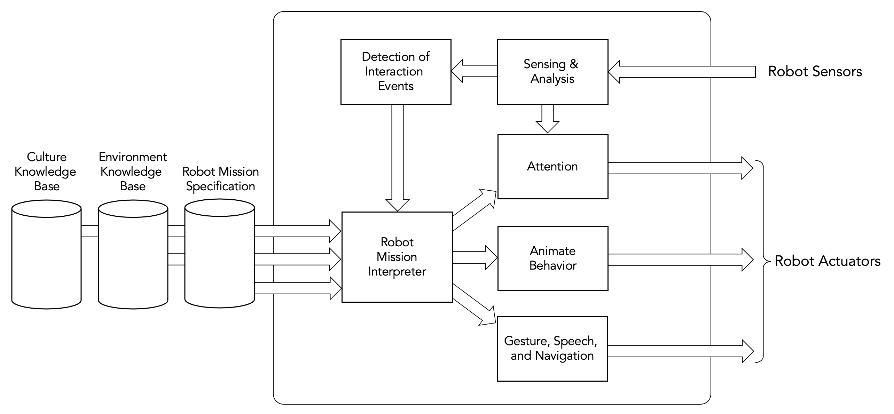
Abstract system architecture for a culturally sensitive social robot
www.cssr4africa.org

Slide 22
ROS system architecture for a culturally sensitive social robot
(All software will be on GitHub at https://github.com/cssr4africa/cssr4africa)
www.cssr4africa.org

Slide 23
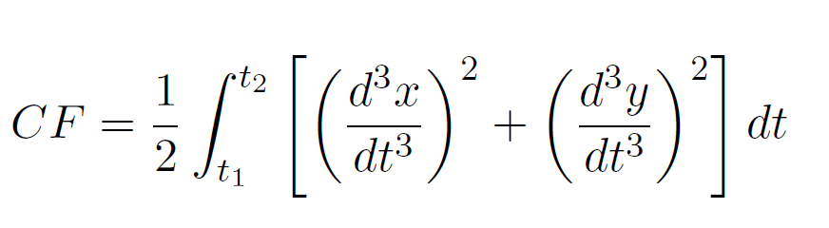
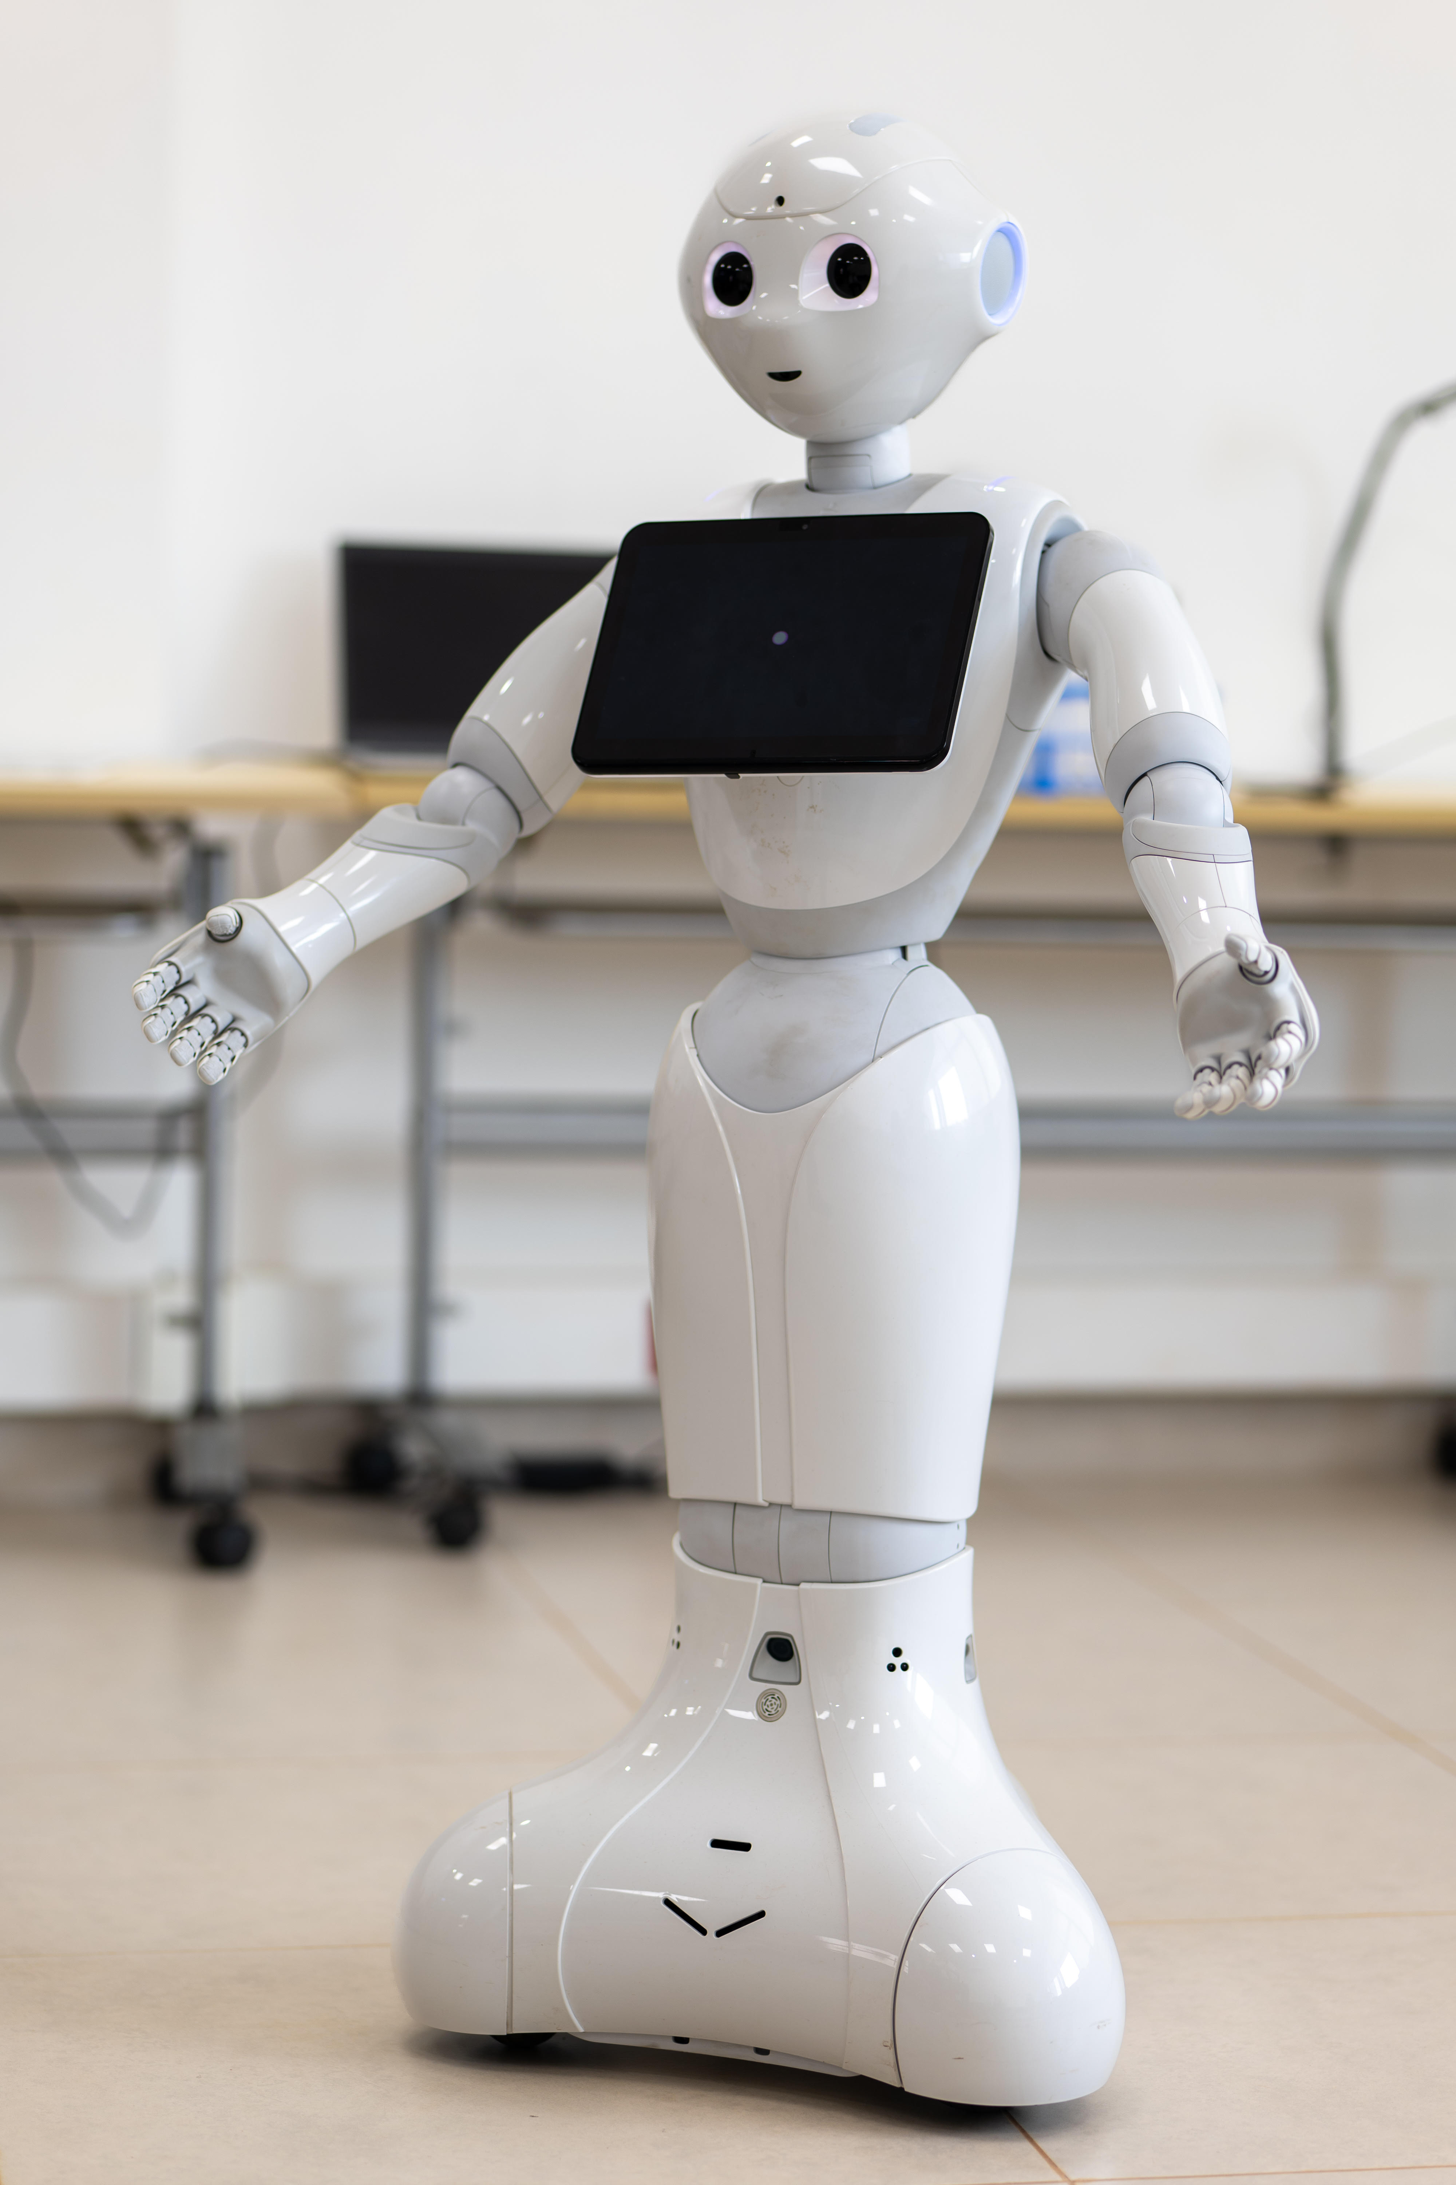
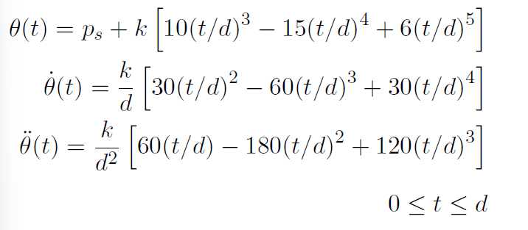
Minimum Jerk Model
Cost function being minimized
Joint position
Joint velocity
Joint acceleration
Biological Motion for Engaging Gestural Communication in Social Robots

Slide 24
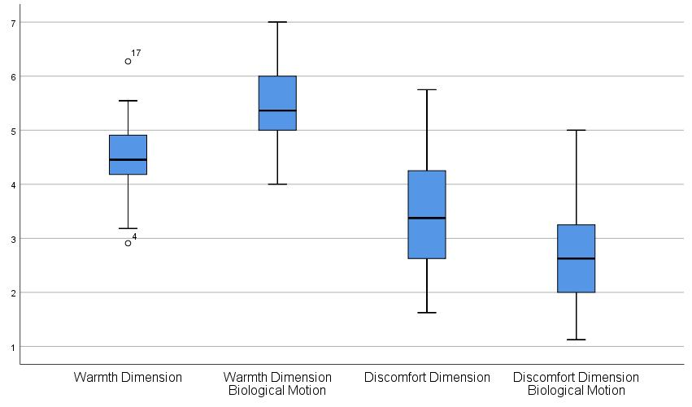
Biological motion during human-robot interactions
Warmth increased on average by 14%
Discomfort reduced by 13%
(assessed using a variation of the RoSAS metric)
Biological Motion for Engaging Gestural Communication in Social Robots

Slide 25
Gesture subsystem in the abstract system architecture
www.cssr4africa.org

Slide 26
Gesture subsystem ROS system architecture
www.cssr4africa.org

Slide 27
Robotics in Africa at IROS 2024 Posters
http://www.vernon.eu/downloads/CMU-Africa_Poster_Culture_Survey.pdf

Slide 28
Robotics in Africa at IROS 2024 Posters
http://www.vernon.eu/downloads/CMU-Africa_Poster_Biological_Motion.pdf

Slide 29
Robotics in Africa at IROS 2024 Posters
http://www.vernon.eu/downloads/CMU-Africa_Poster_Behaviour_Trees.pdf

Slide 30
Selected Publications
A. Akinade, D. Barros, M. Danso, Y. Haile, E. Birhan, B. Shimelis Girma, C. Osano, P. Ranchod, M. Richard, B. Rosman, I. Jimoh, T. Taye Tefferi, D. Vernon, "Culturally Sensitive Social Robotics for Africa", Proceedings of the 2nd International Workshop on Cultural Robotics: Diversified Sustainable Practices, IEEE/ACM HRI 2025, Springer LNAI, in press.
A. Akinade, D. Barros, and D. Vernon, "Biological Motion Aids Gestural Communication by Humanoid Social Robots", International Journal of Humanoid Robotics, Vol. 22, No. 2, 2025.
D. Vernon, "An African Perspective on Culturally Competent Social Robotics: Why DEI Matters in HRI", IEEE Robotics and Automation Magazine, Vol. 31, No. 4, pp. 170-200, 2024.
A. Akinade and D. Vernon, Biological Motion for Gestural Communication in Social Robots, accepted for presentation at Robotics in Africa Forum, IEEE/RSJ International Conference on Intelligent Robotics and Systems (IROS), Abu Dhabi, UAE, October 17th, 2024.
E. Birhan and D. Vernon, Surveying Rwandan Cultural Knowledge for Respectful Human-Robot Interaction in Africa, accepted for presentation at Robotics in Africa Forum, IEEE/RSJ International Conference on Intelligent Robotics and Systems (IROS), Abu Dhabi, UAE, October 17th, 2024.
I. O. Jimoh, H. S. Equbay, C. Onyonka, T. Tefferi, and D. Vernon, Behavior Trees for Culturally Sensitive Social Robots: African Culture Case Study, accepted for presentation at Robotics in Africa Forum, IEEE/RSJ International Conference on Intelligent Robotics and Systems (IROS), Abu Dhabi, UAE, October 17th, 2024.
A. Akinade, Y. Haile, N. Mutangana, C. Tucker, and D. Vernon, “Culturally Competent Social Robots Target Inclusion in Africa”, Science Robotics, 2023.
P. Zantou and D. Vernon, "Culturally-Sensitive Human-Robot Interaction: A Case Study with the Pepper Humanoid Robot", Proc. IEEE Africon, Nairobi, Kenya, September, 2023.
P. Zantou and D. Vernon, "Inclusion Drives Sustainable Development: The Case of Social Robotics for Africa", Poster Presentation, ACM SIGCAS/SIGCHI Conference on Computing and Sustainable Societies - COMPASS, August 2023.
https://cssr4africa.github.io/publications

Slide 31
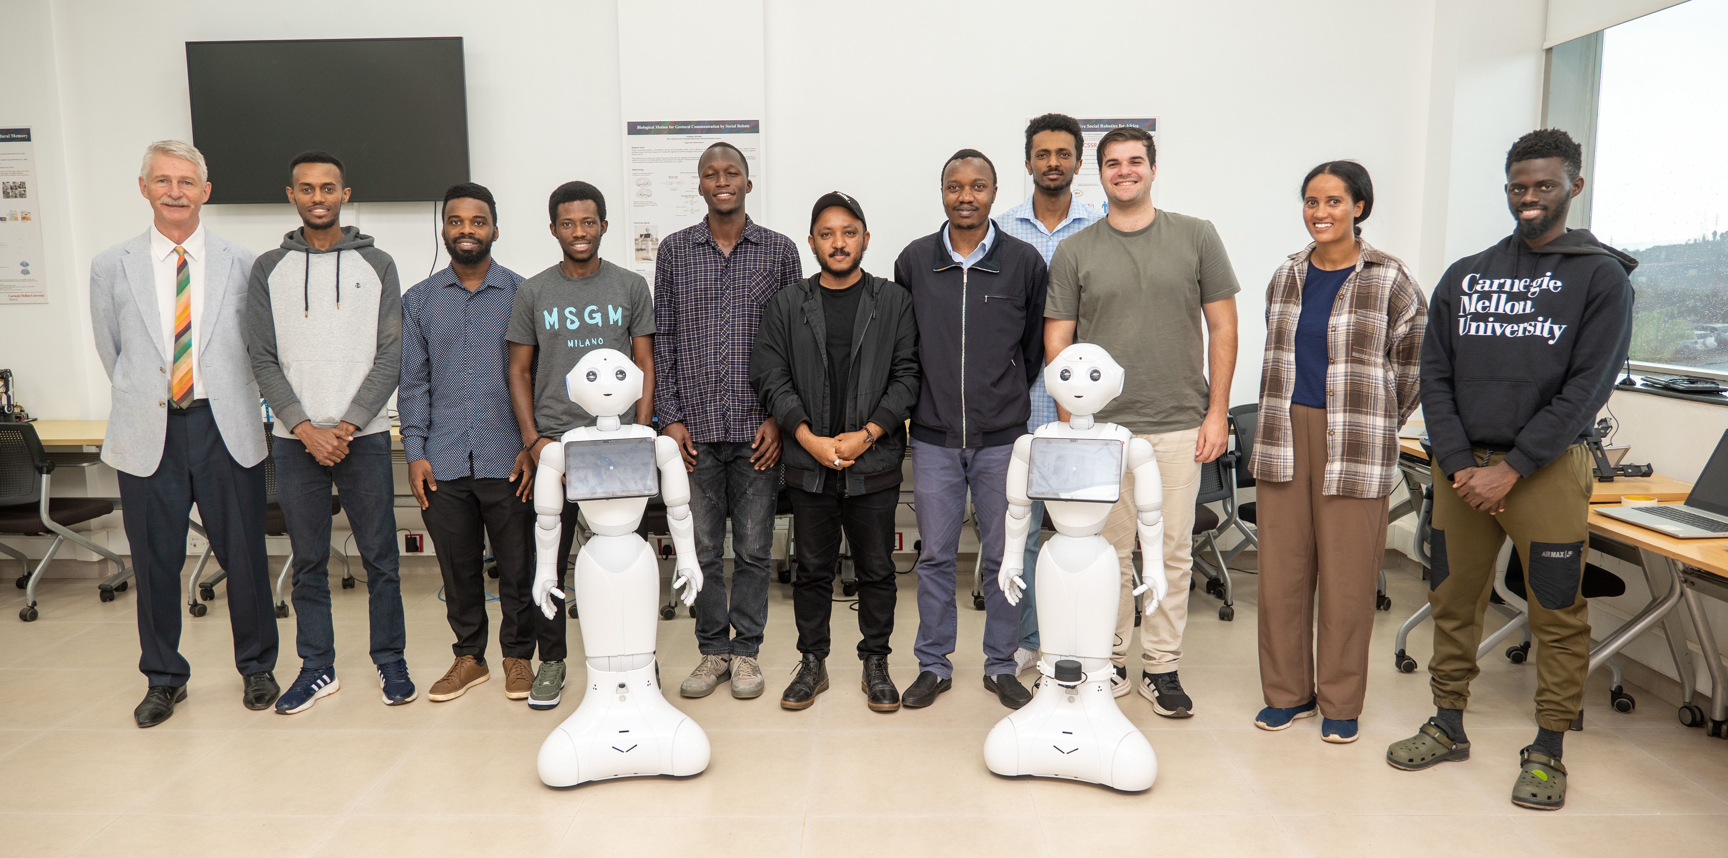

Slide 32
Adedayo Akinade Benjamin Rosman (PI) Birhanu Shimelis Girma Clifford Osano Daniel Barros David Vernon (PI) Eyerusalem Birhan Heran Equbay Ibrahim Jimoh
CSSR4Africa Team
Kleber Kabanda Mihiretab Taye Hordofa Muhammed Danso Muhirwa Richard Natasha Mutangana Pamely Zantou
Pravesh Ranchod (PI) Tsegazaeb Taye Tefferi Yohannes Haile

Slide 33
Thanks to our collaborators Dr. Pravesh Ranchod & Prof. Benjamin Rosman
https://www.wits.ac.za/

Slide 34

This work was carried out as part of the African Engineering and Technology Network (Afretec) Afretec is managed by Carnegie Mellon University Africa and receives financial support from the Mastercard Foundation
https://engineering.cmu.edu/afretec/index.html

Slide 35
<Name of Event Goes Here>
<Event Logo Goes Here>
<Date of Event Goes Here>
Culturally Competent Social Robotics for Africa
<Name of Presenter Goes Here>
Select your logo or logos

